Slide 1

DWH FINAL PROJECT
By : Adulrahman khalifa
Mohamed Roshdy
Hana Hatem
Elaf Mustafa

Slide 2

Gravity
bookstore db

Slide 3

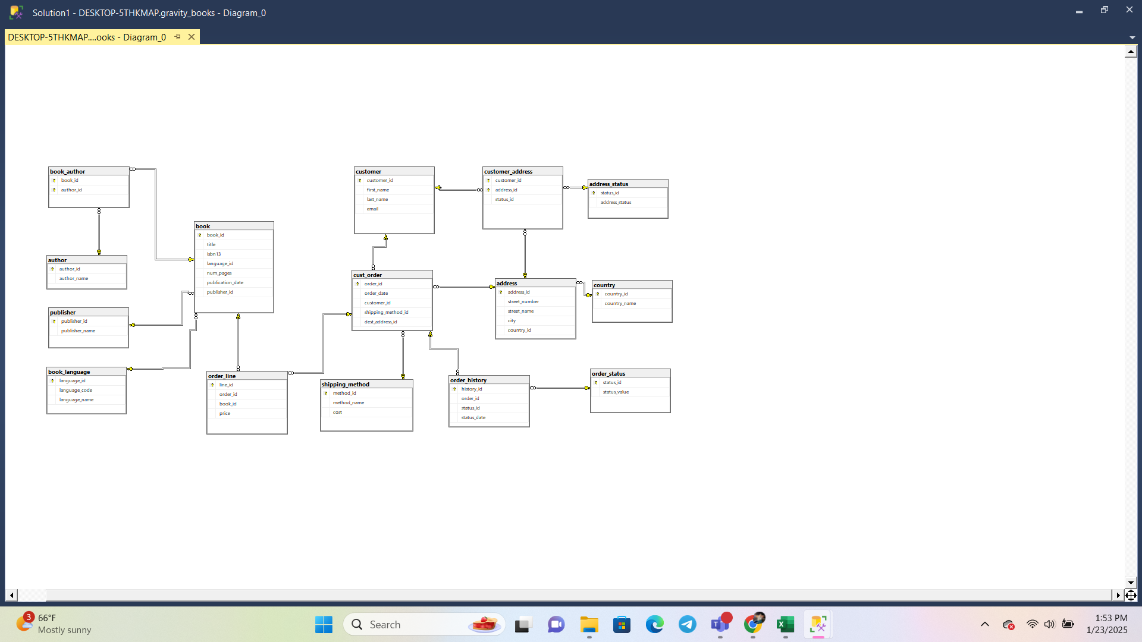
Gravity bookstore DB diagram

Slide 4
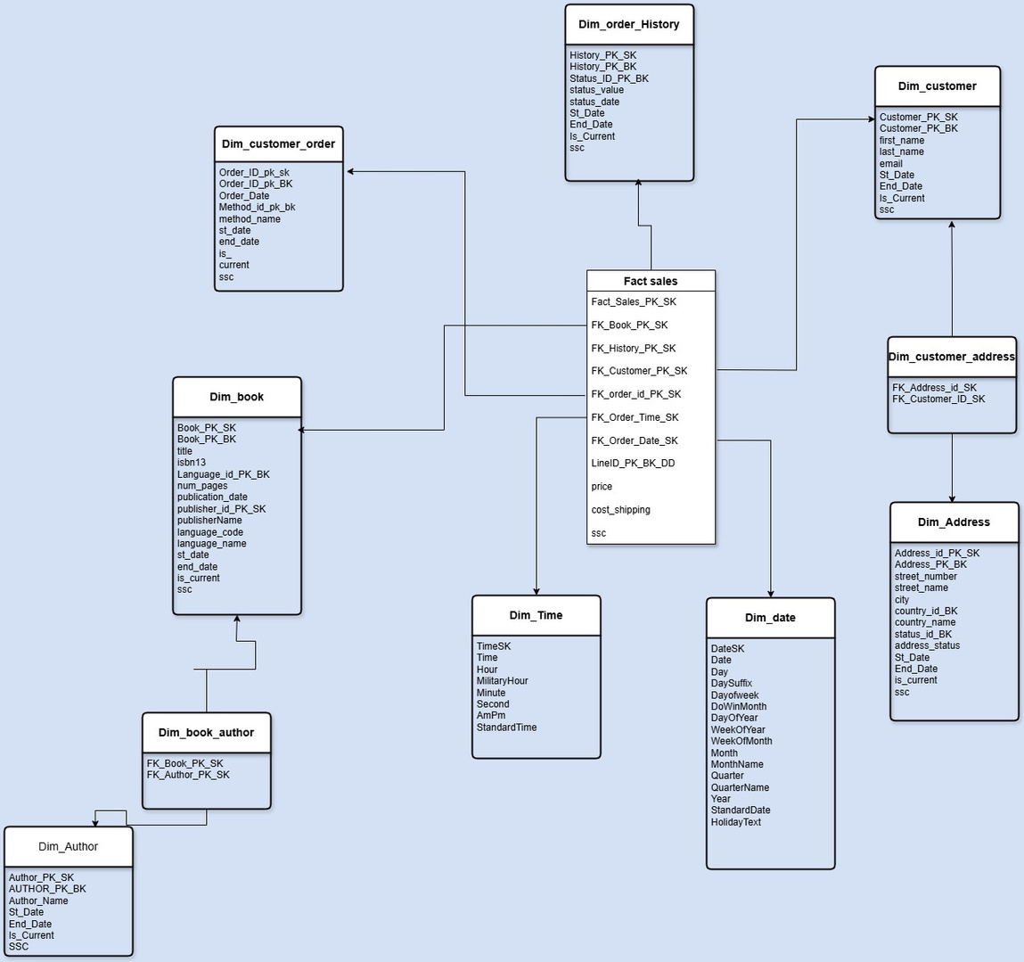
Gravity bookstore
snow flake schema

Slide 5
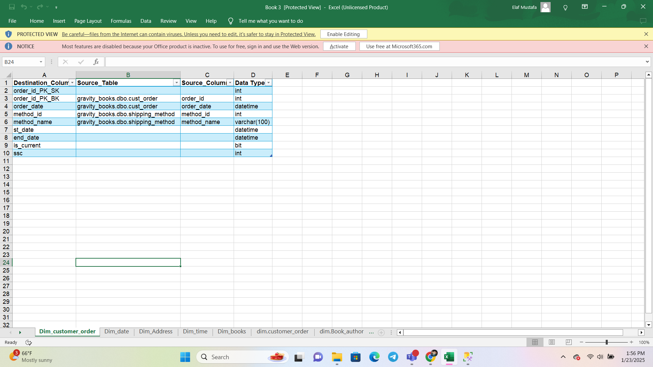
Mapping facts & dimensions
Customer_order dimension

Slide 6
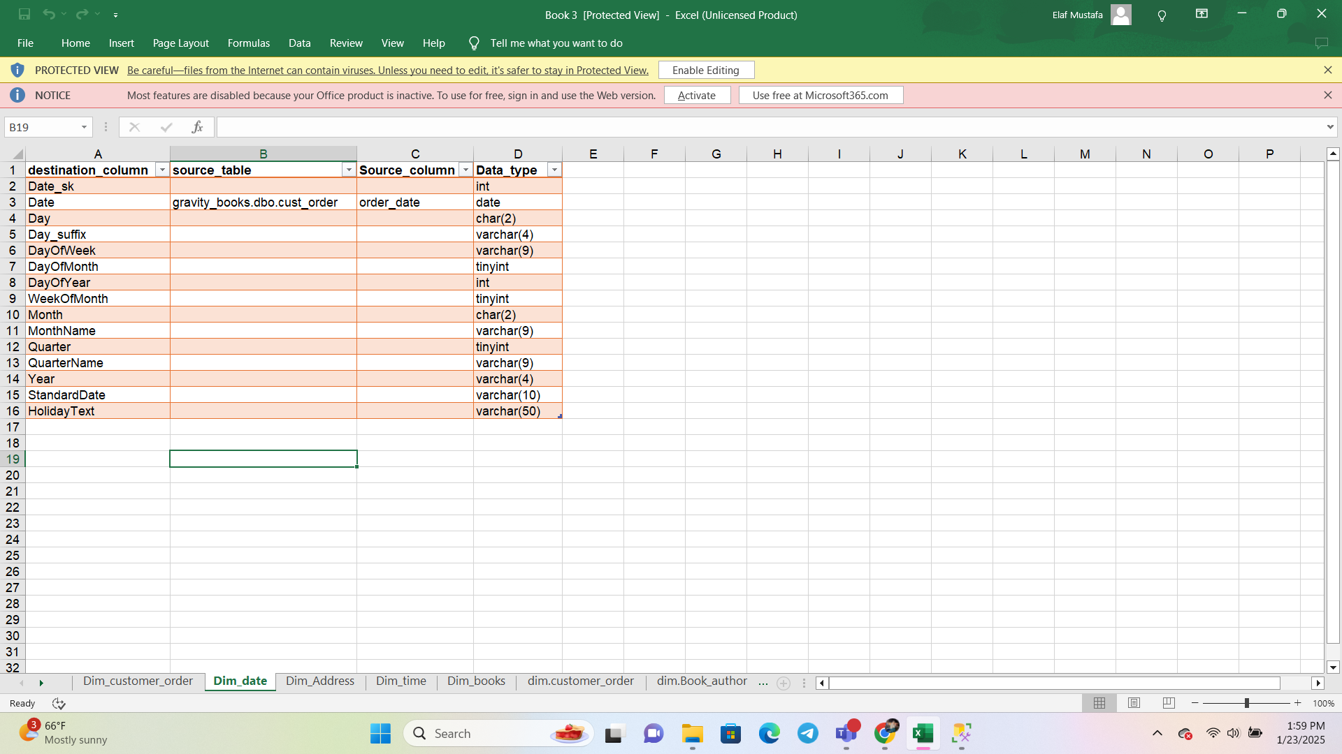
MAPPING FACTS & DIMENSIONS
Date dimension

Slide 7
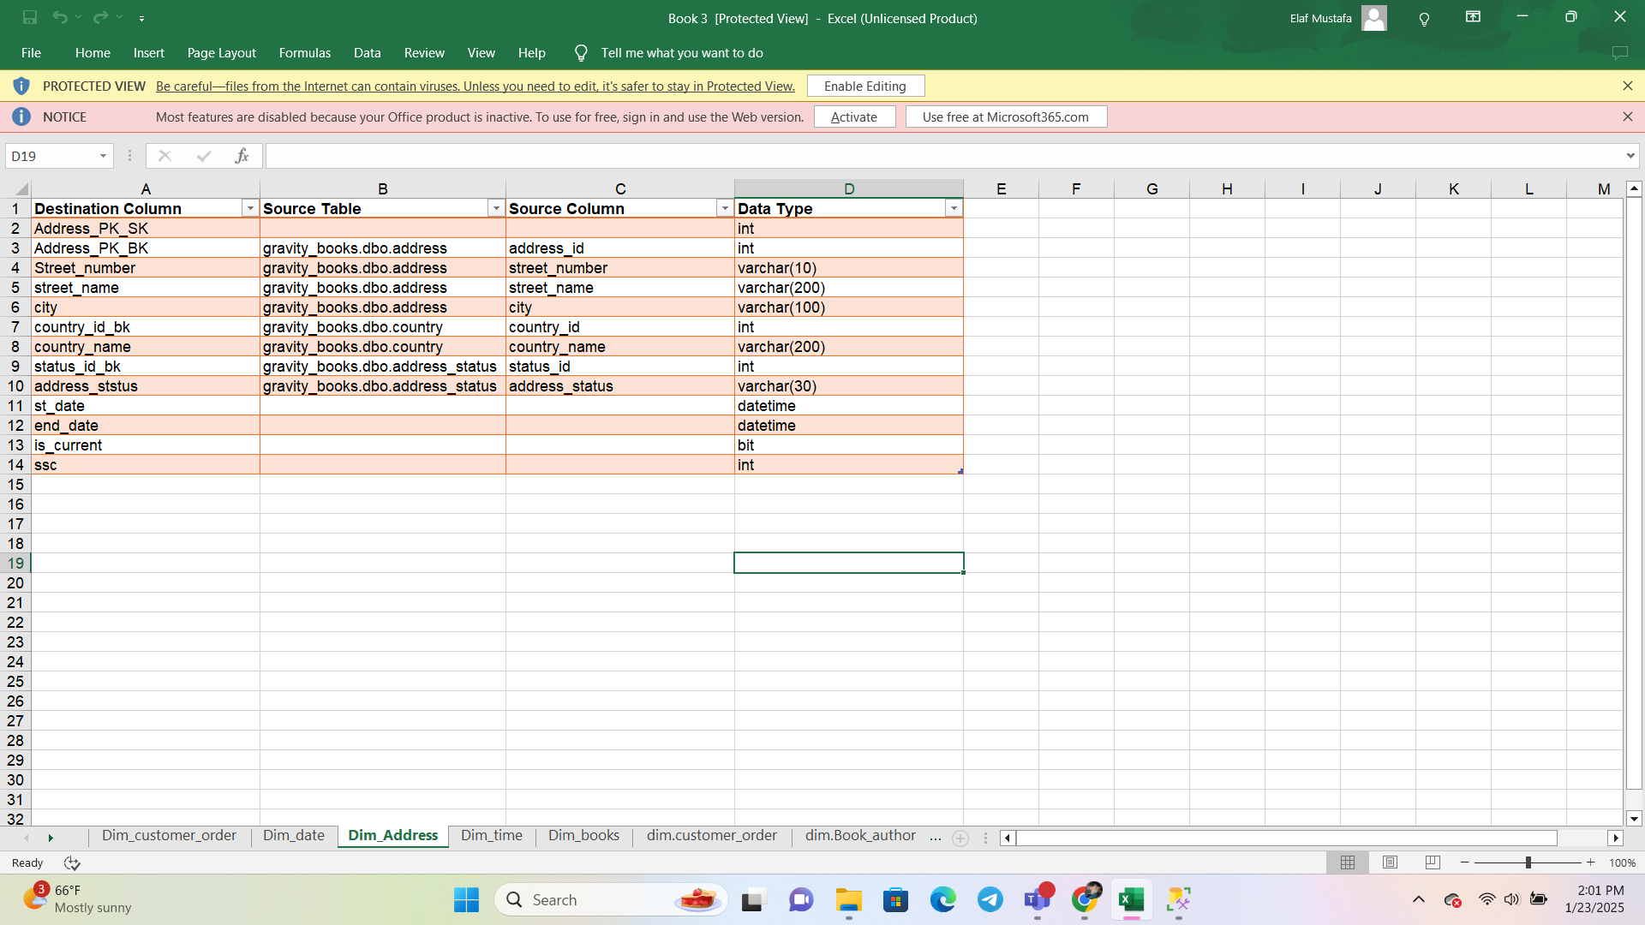
MAPPING FACTS & DIMENSIONS
Address dimension

Slide 8
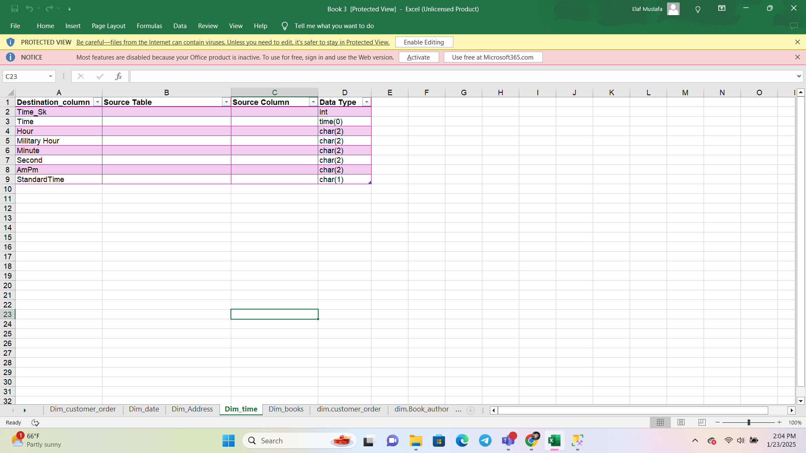
MAPPING FACTS & DIMENSIONS
Time dimension

Slide 9
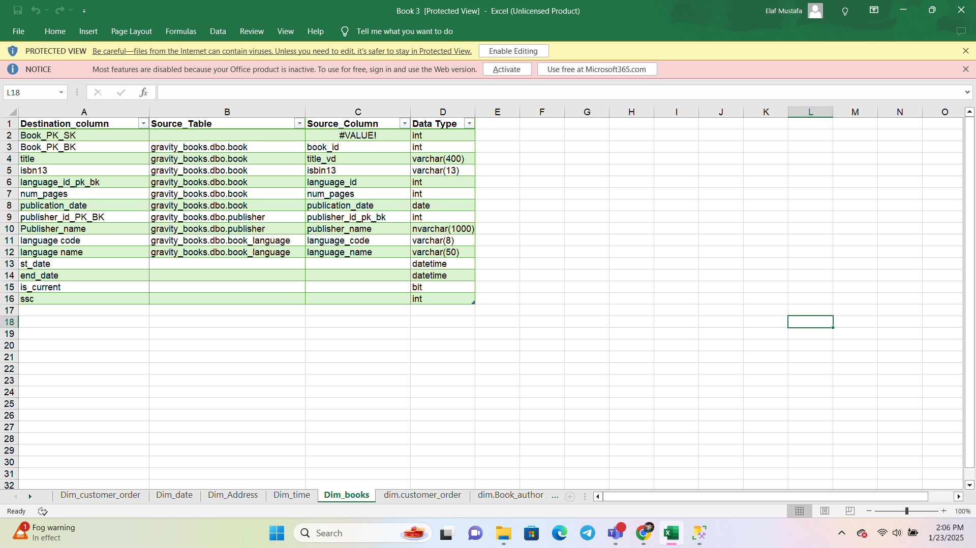
MAPPING FACTS & DIMENSIONS
Book dimension

Slide 10
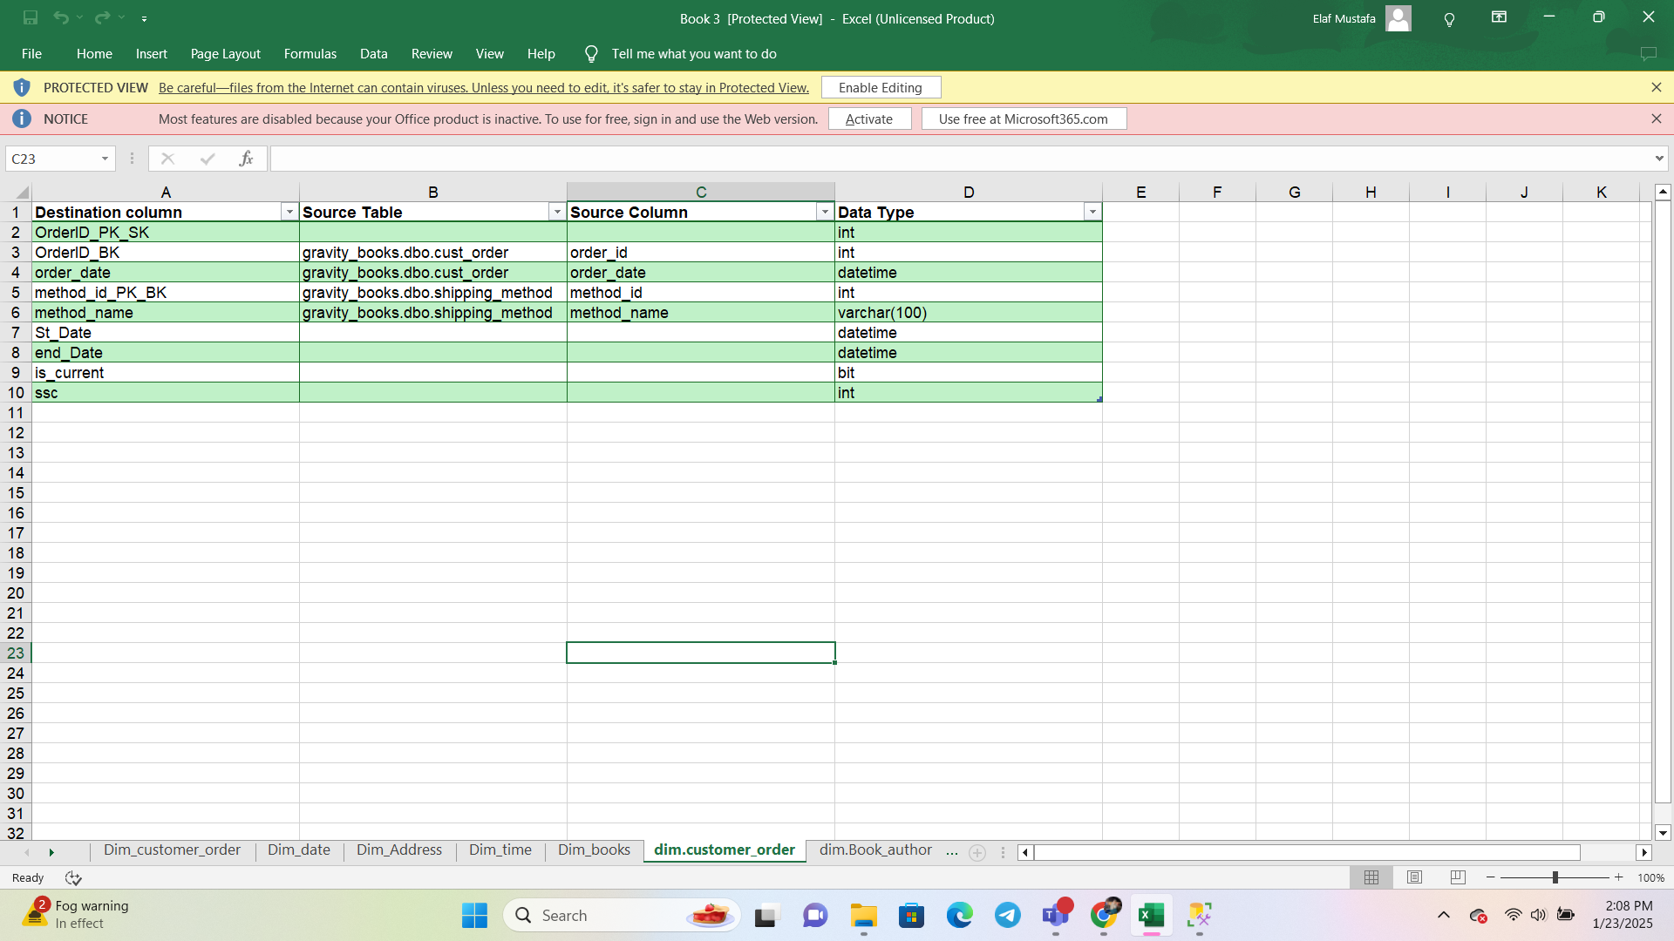
MAPPING FACTS & DIMENSIONS
Customer order dimension

Slide 11
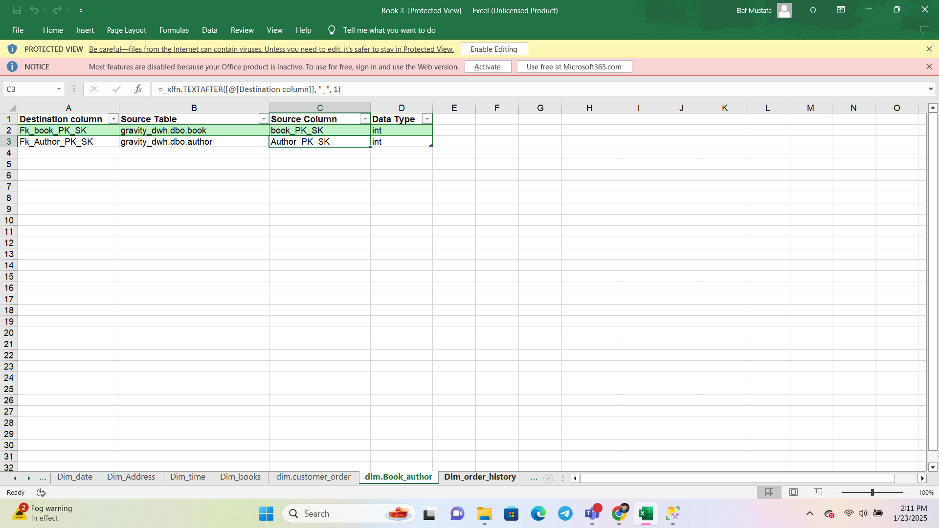
MAPPING FACTS & DIMENSIONS
Book author dimension

Slide 12
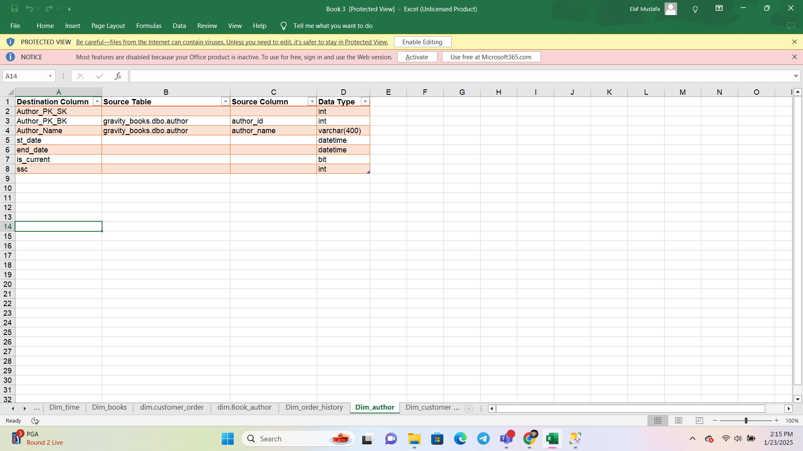
MAPPING FACTS & DIMENSIONS
Author dimension

Slide 13
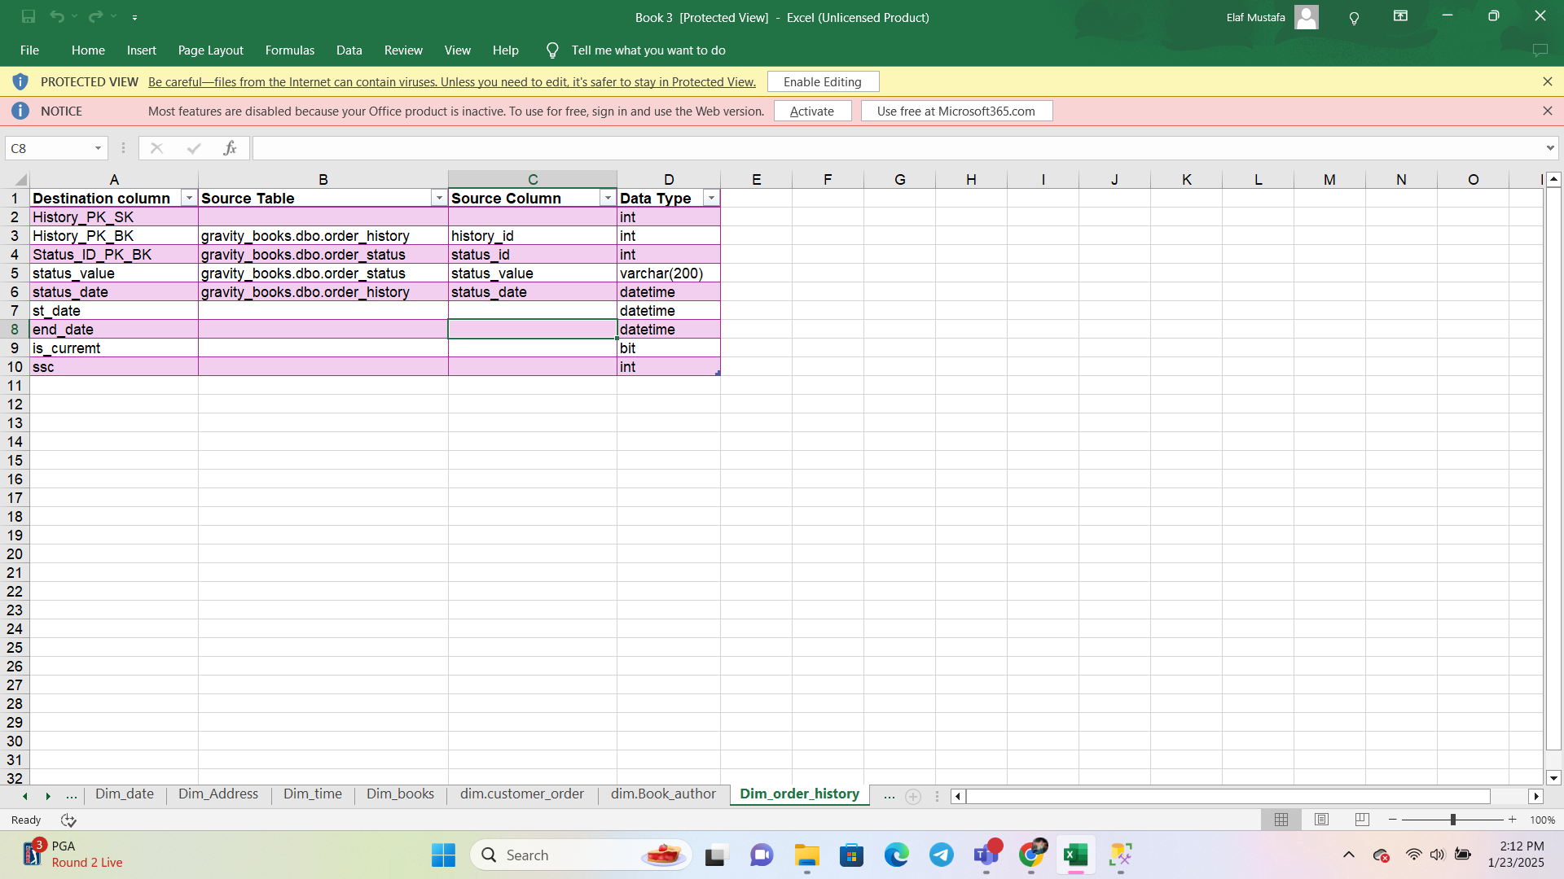
MAPPING FACTS & DIMENSIONS
Order history dimension

Slide 14
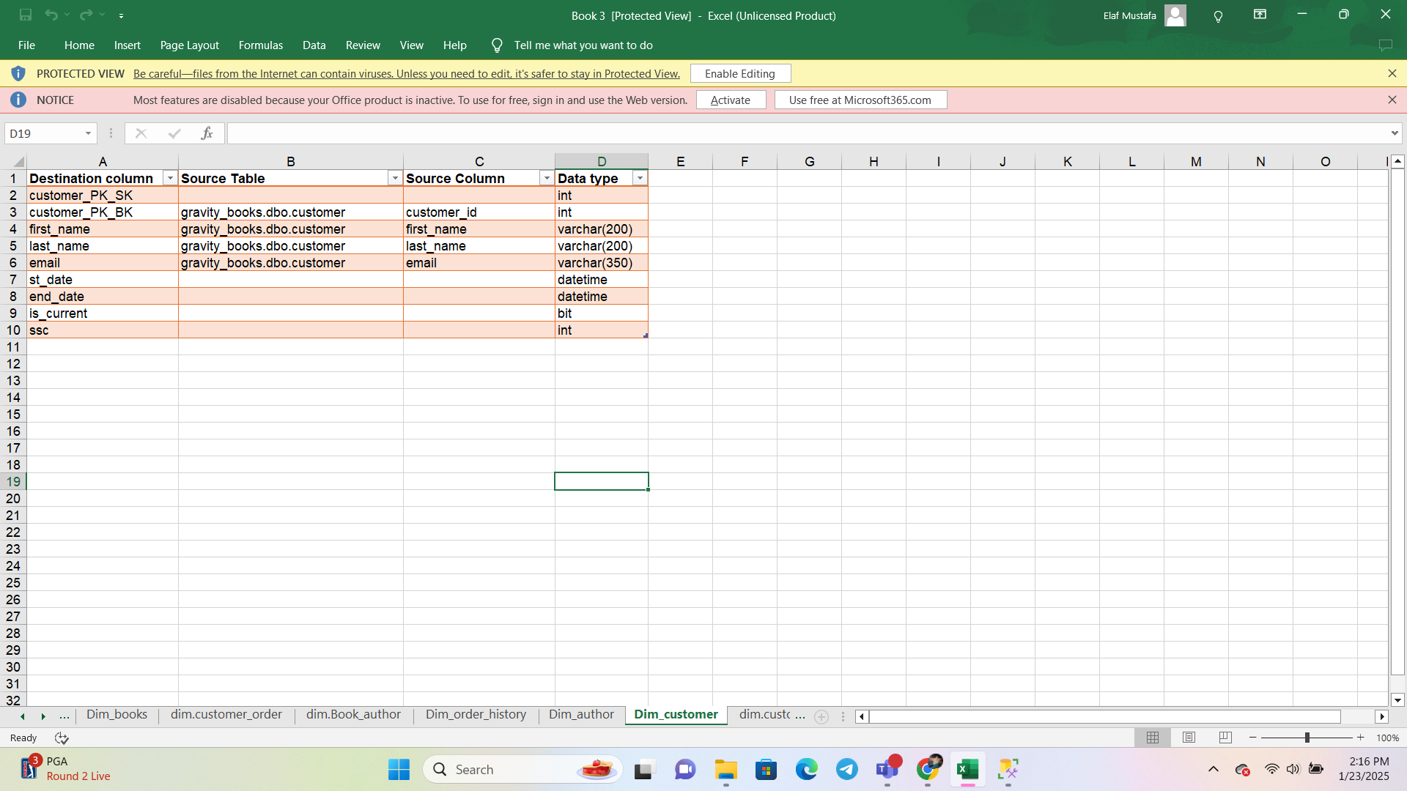
MAPPING FACTS & DIMENSIONS
Customer dimension

Slide 15
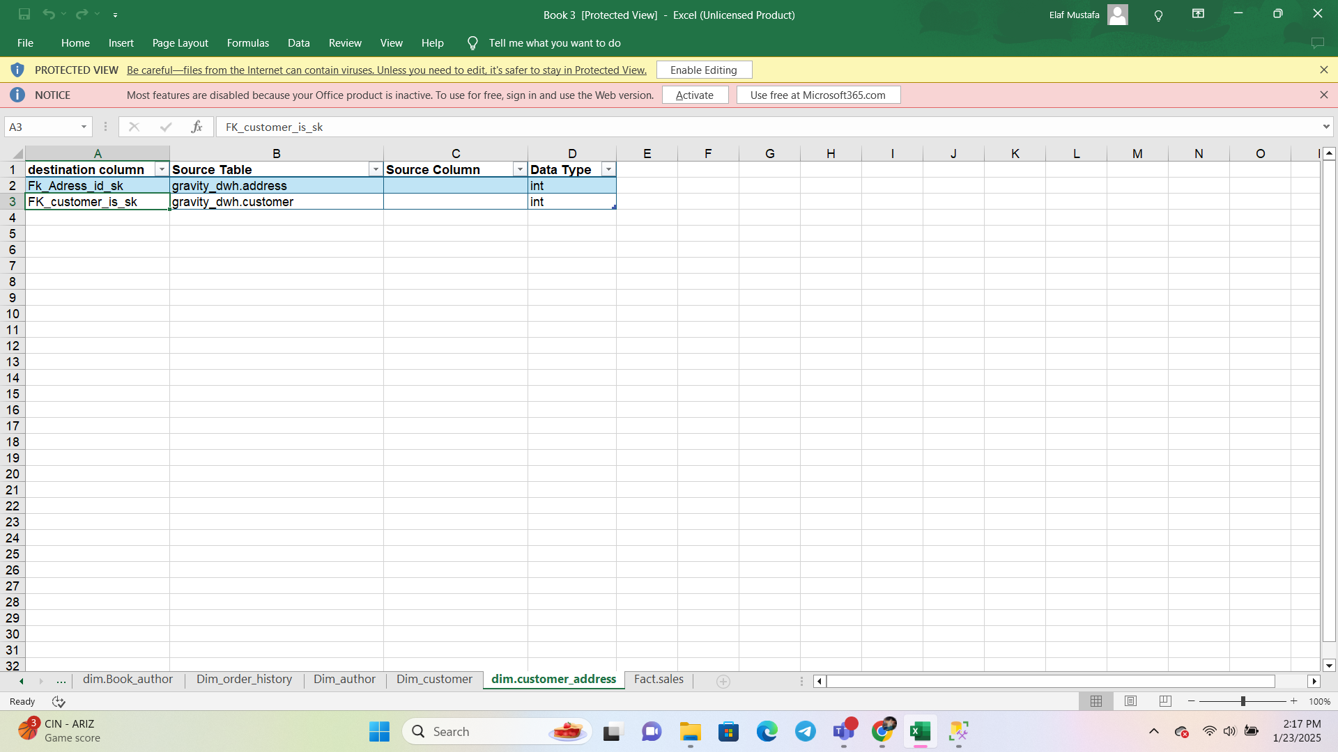
MAPPING FACTS & DIMENSIONS
Customer_address dimension

Slide 16
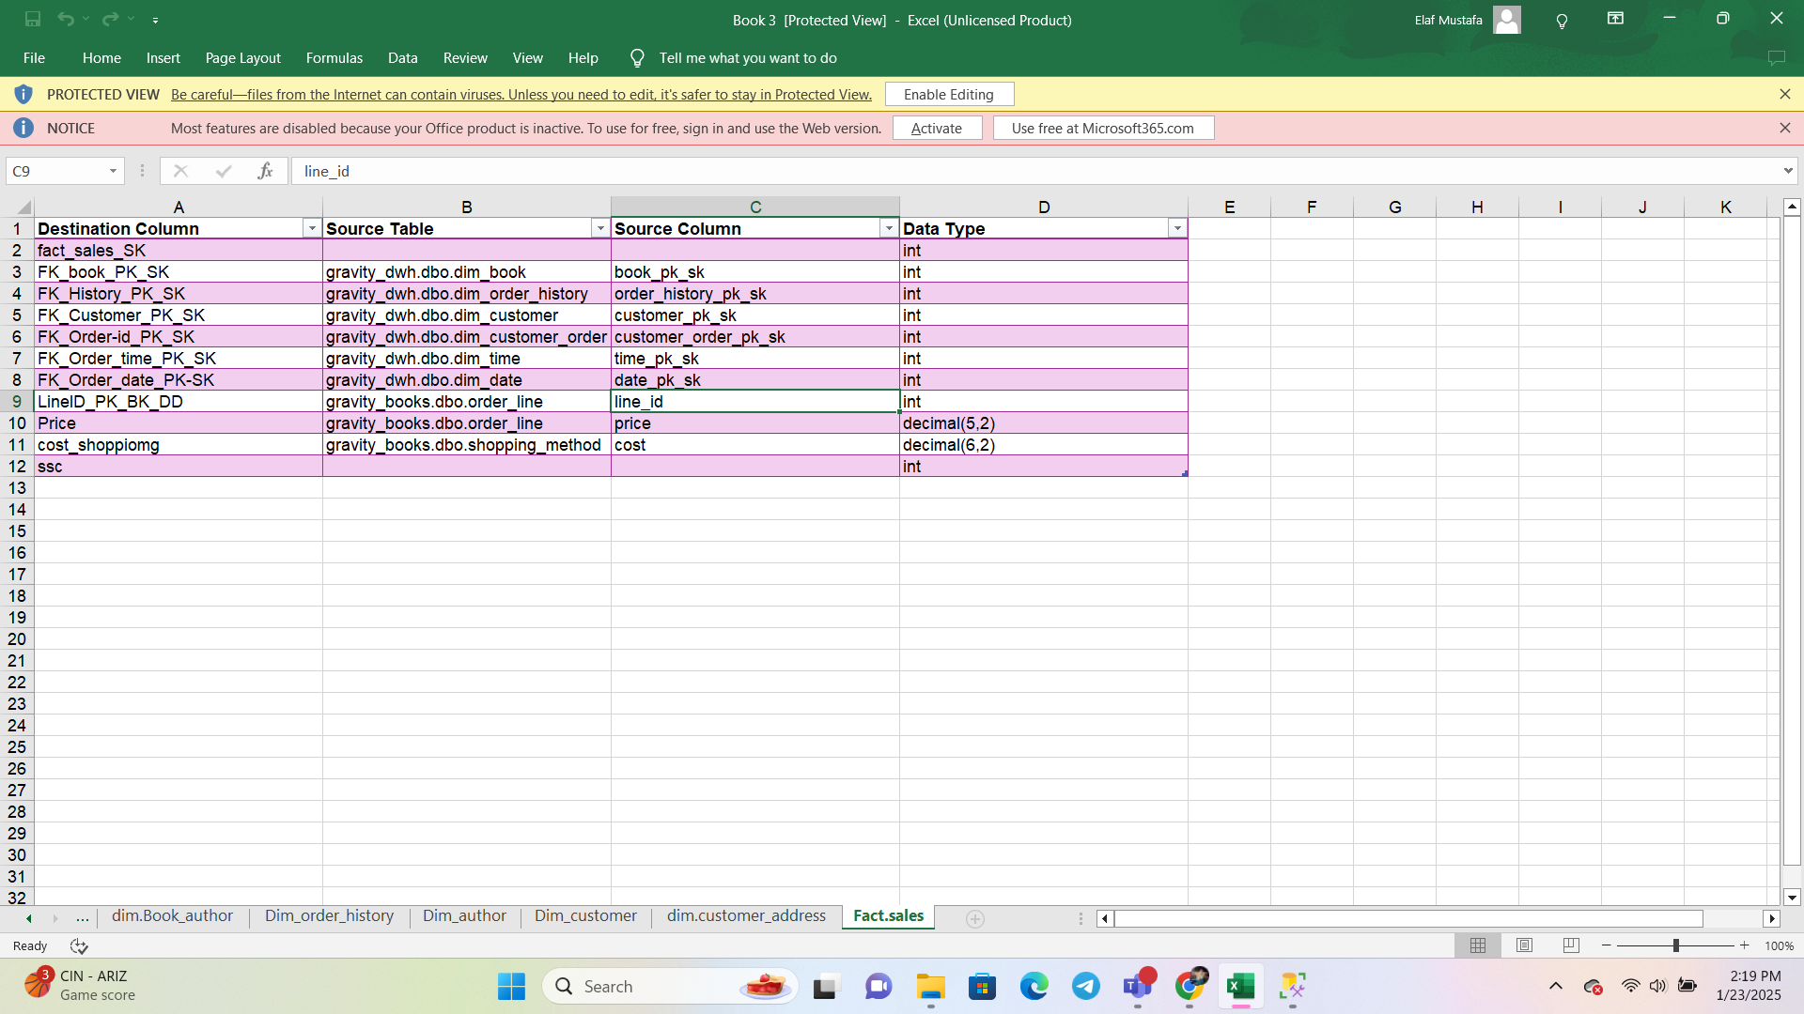
MAPPING FACTS & DIMENSIONS
Sales fact

Slide 17
SSIS

Slide 18
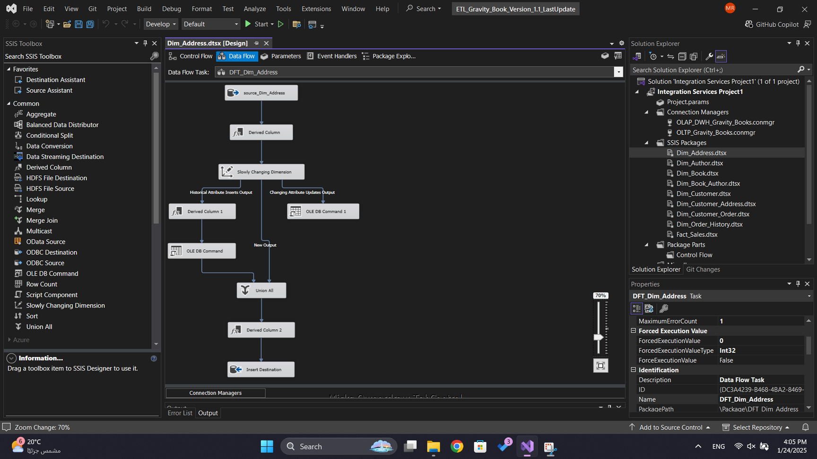

Slide 19
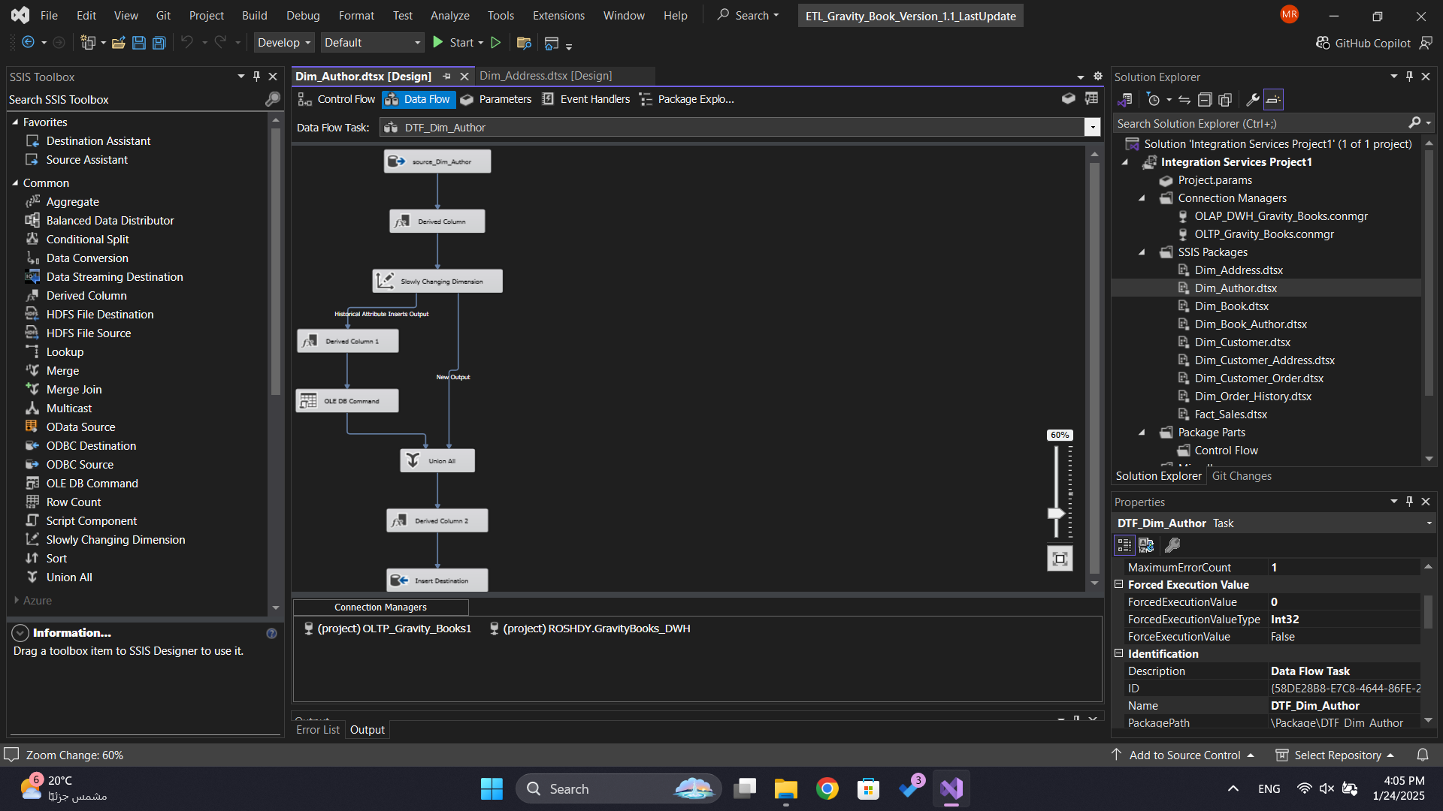

Slide 20
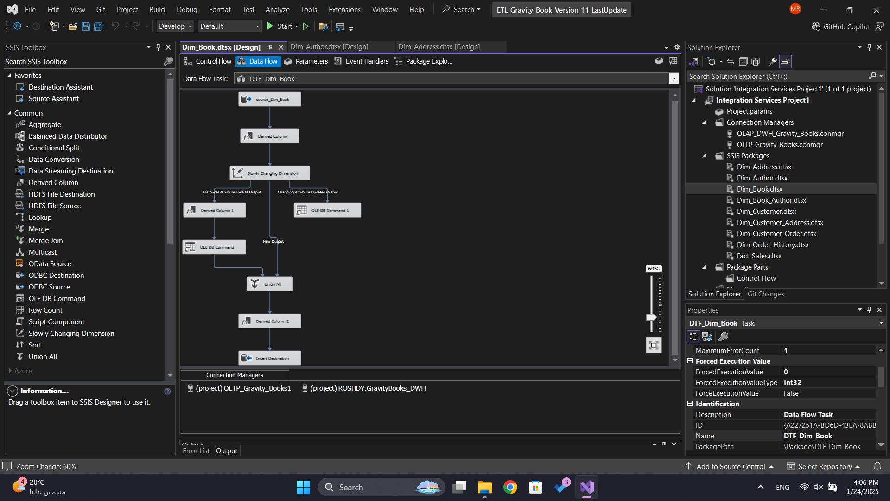

Slide 21
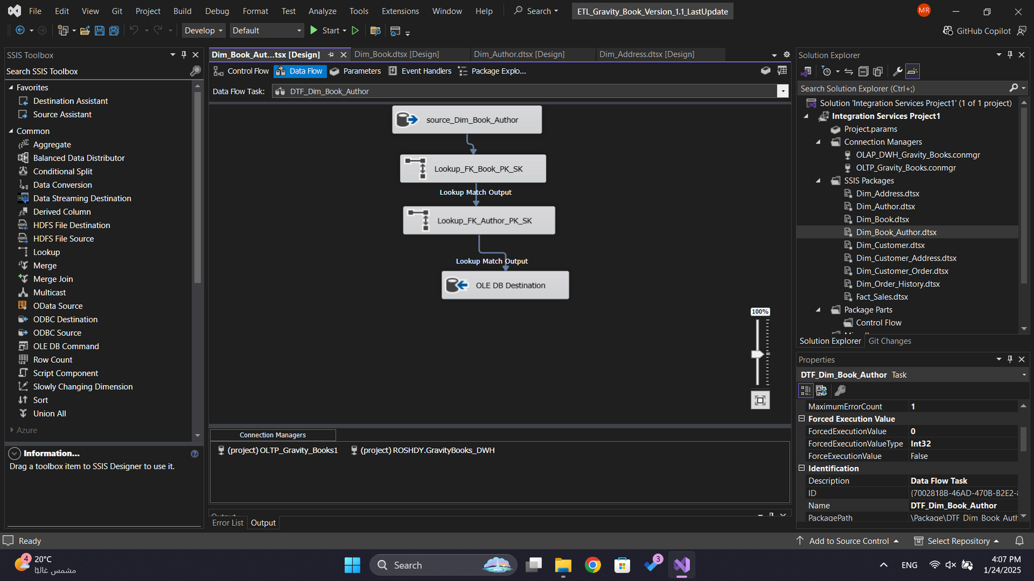

Slide 22
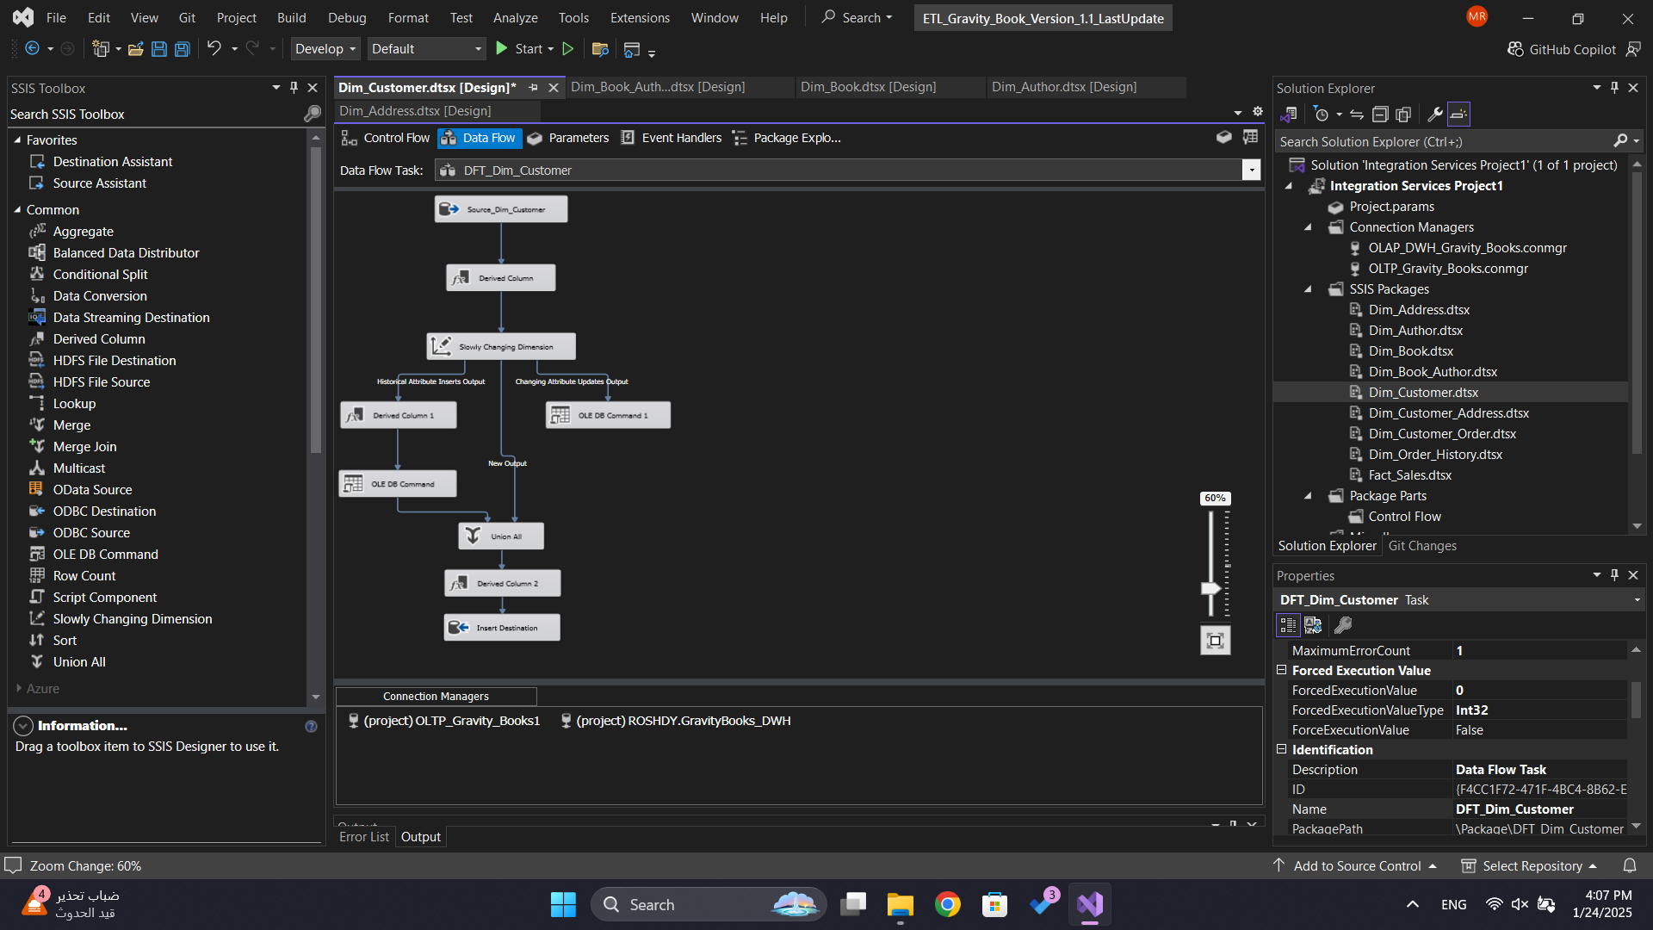

Slide 23
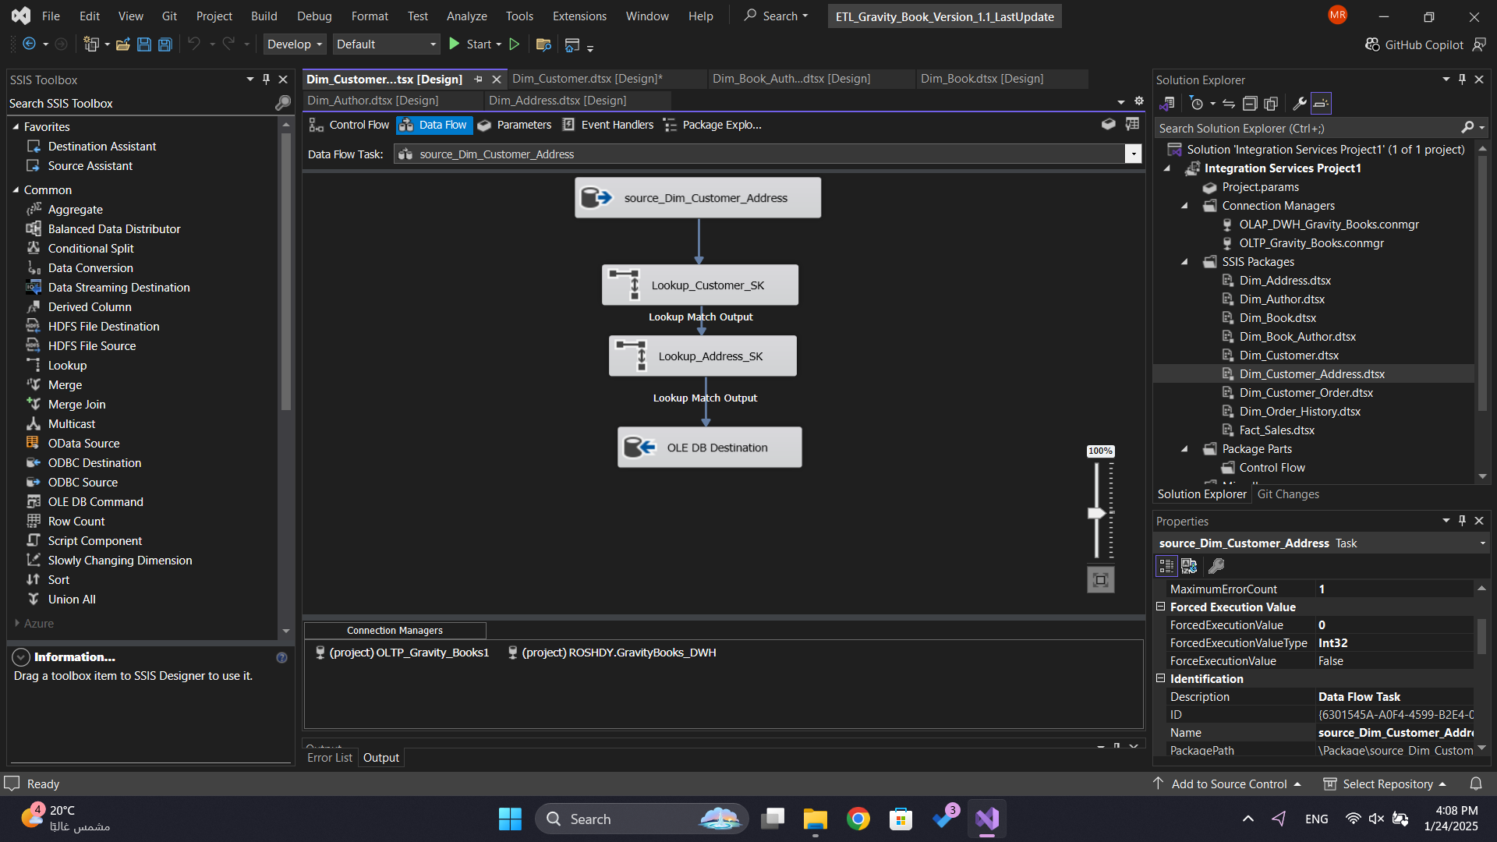

Slide 24
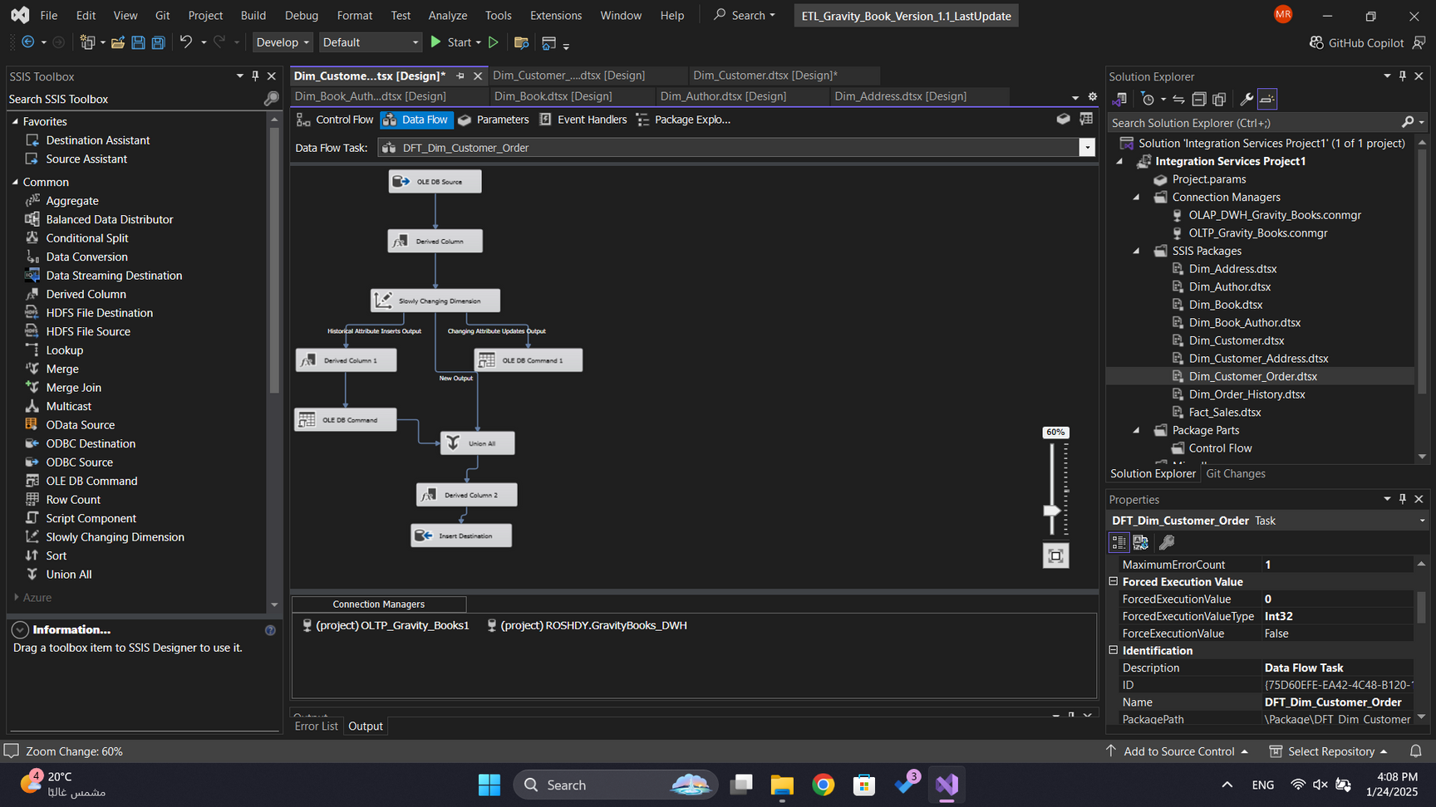

Slide 25
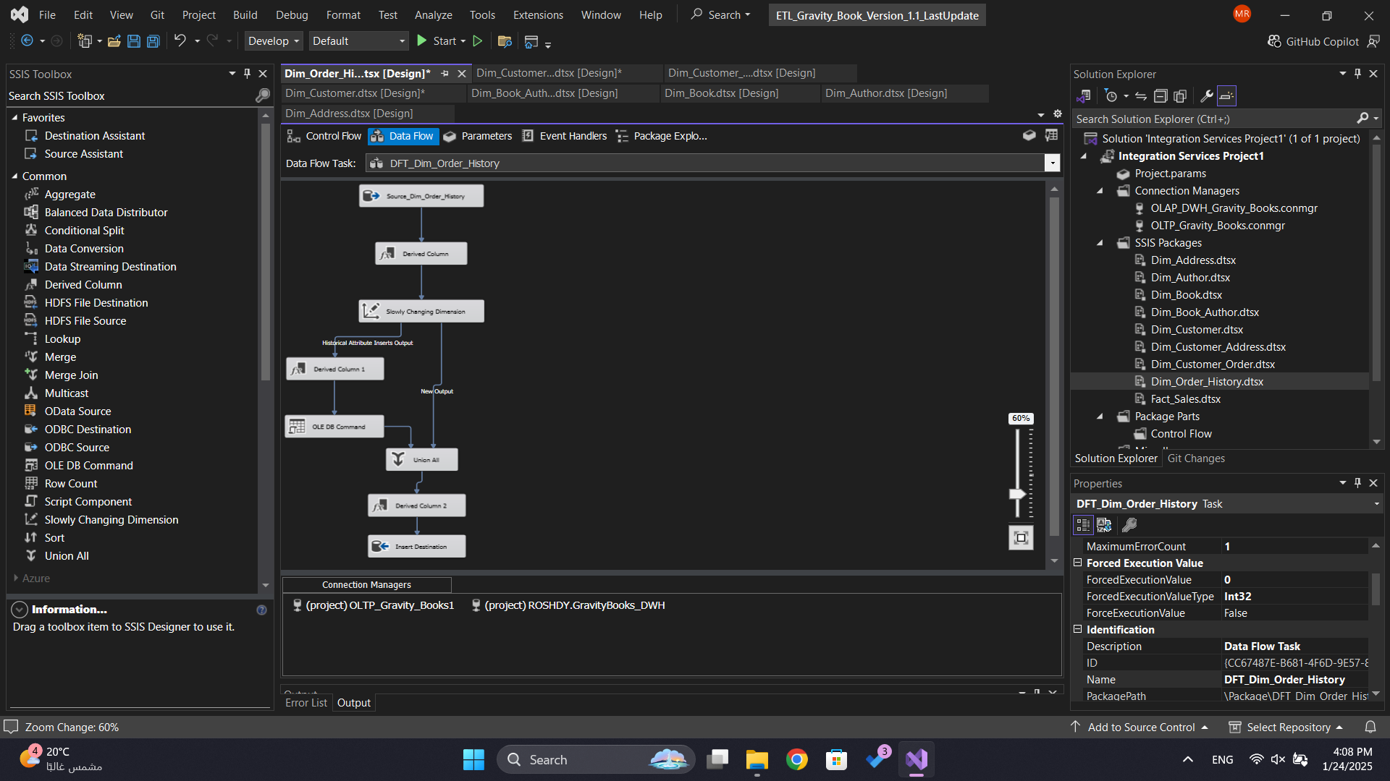

Slide 26
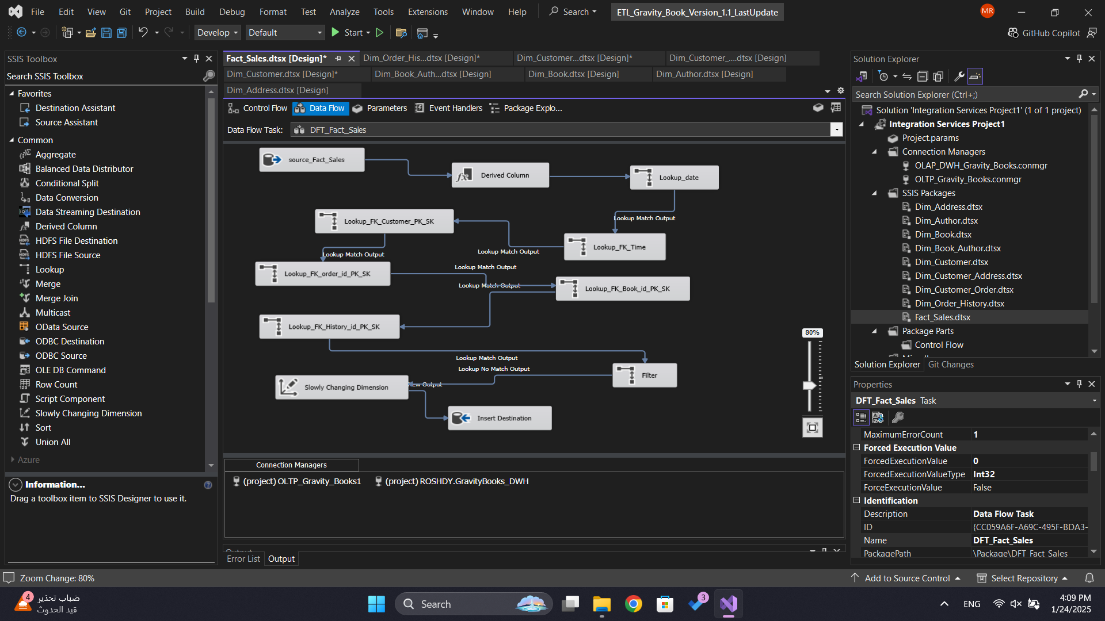

Slide 27
SSAS

Slide 28
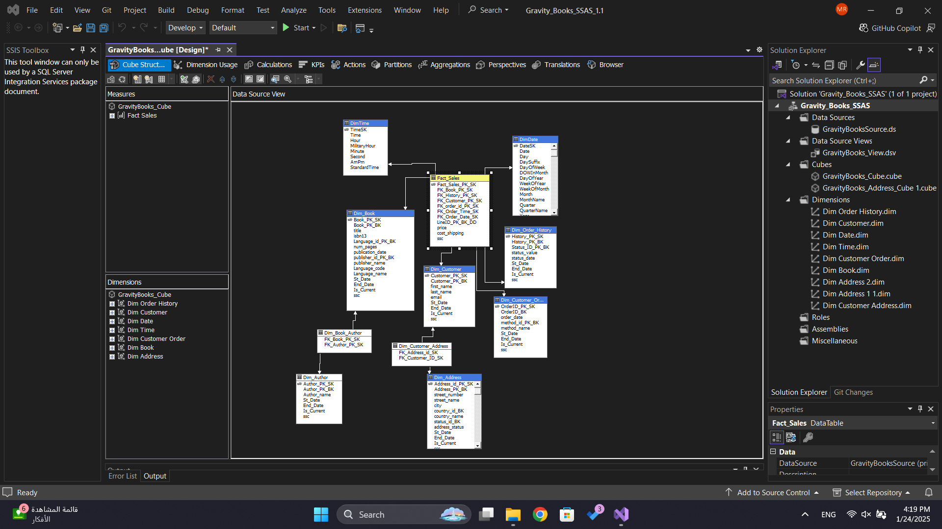

Slide 29
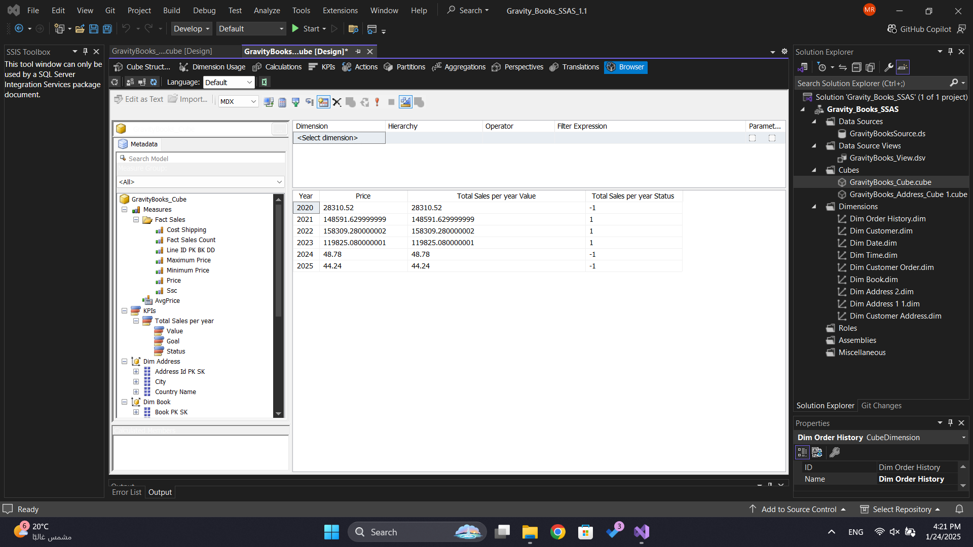

Slide 30
THANK YOU

